Slide 1
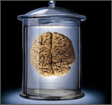

Soccer-Fun functional programming with football
http://www.cs.ru.nl/P.Achten/SoccerFun/SoccerFun.html

Slide 2
What is Soccer-Fun?
Program the brain of a footballer
Build a team of eleven football players
Play against other teams and see if your team is best
Inspired by a citation from Johan Cruijff

Slide 3
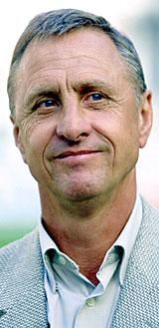
Football brain
Johan Cruijff (De Tijd, may 7 1982):
“If I am in possession of the ball and I want to play it to another team member, I need to take my direct opponent into account, as well as the wind, the grass, and the speed with which other players run. We compute the strength with which to kick and the direction in which to do so in a tenth of a second. The computer needs two minutes for this!”

Slide 4
Voetbalbrein
Johan Cruijff (De Tijd, 7 mei 1982):
“If I am in possession of the ball and I want to play it to another team member, I need to take my direct opponent into account, as well as the wind, the grass, and the speed with which other players run. We compute the strength with which to kick and the direction in which to do so in a tenth of a second. The computer needs two minutes for this!”
This computation is a function:
brain :: Opponent Wind Grass Players → (Strength, Direction)

Slide 5
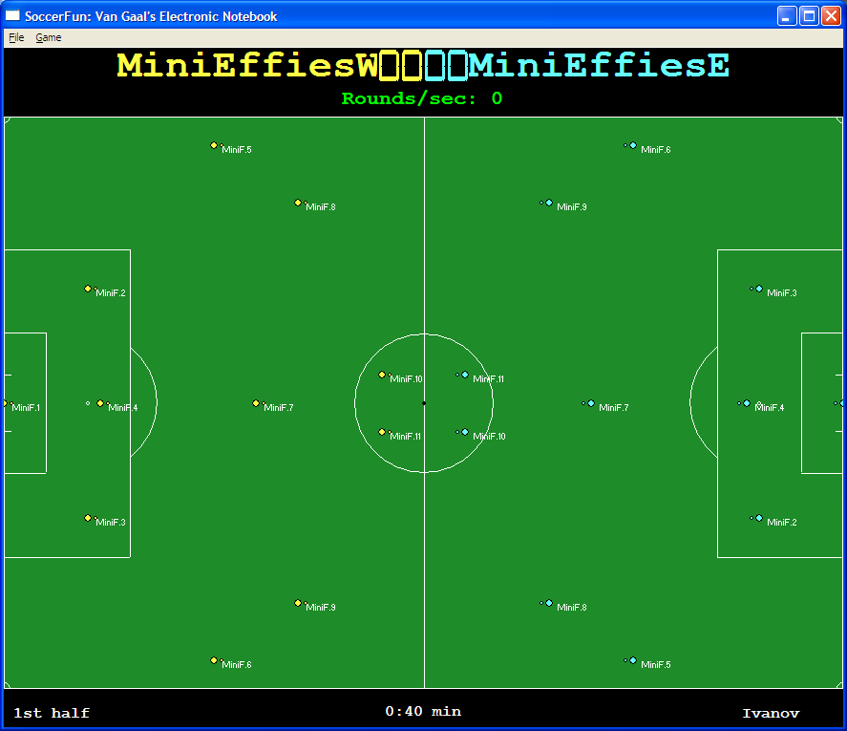
Soccer-Fun

Slide 6
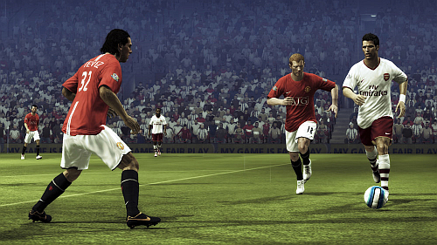
Model football(er)s

Slide 7
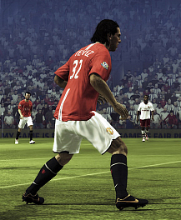
Footballer
:: Footballer = E.m:
{ playerID :: FootballerID, nose :: Angle
, pos :: Position, speed :: Speed
, name :: String, length :: Length
, stamina :: Stamina, health :: Health
, skills :: MajorSkills
, effect :: Maybe FootballerEffect
, brain :: Brain (FootballerAI m) m
}

Slide 8
“Our” brain is also a function
name
arguments
result
minibrain
:: (BrainInput, Memory) -> (BrainOutput,Memory)
function-type
minibrain
(input, memory)
| condition₁ = (output₁,memory₁)
| condition₂ = (output₂,memory₂)
| otherwise = (output_{n},memory_{n})
function-
body
where
result = computation
partial computations

Slide 9
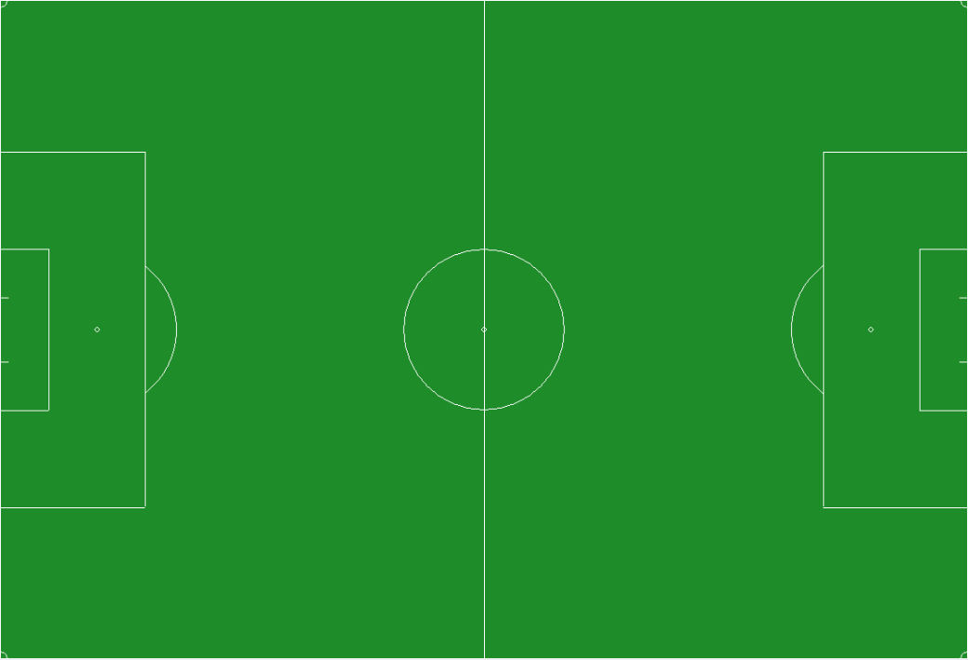
Dimensions – football field
fwidth
(64m-75m)
flength (100m – 110m)
:: FootballField = { fwidth :: FieldWidth, flength :: FieldLength}
:: FieldWidth :== Metre
:: FieldLength :== Metre
m :: Real -> Metre

Slide 10
Dimensions
Eenheid | English | Soccer-Fun |  | Type
length | 0 m 50.4 m | (m 0.0) (m 50.4) | or: zero | Metre
time | 0 min 45 min | (minutes 0.0) (minutes 45.0) | or: zero | Minutes
angle | 0° 90° 180° 270° | (degree 0) (degree 90) (degree 180) (degree 270) | or: zero or: (rad (0.5*pi)) or: (rad pi) or: (rad (1.5*pi)) | Angle
velocity | 0 m/s 10 m/s | (ms 0.0) (ms 10.0) | or: zero | Velocity

Slide 11
Dimensions – football field
North
West
East
South
:: Edge = North | South
:: Home= West | East

Slide 12
Dimensions – coordinates
py
zero
px
:: Position = { px :: Metre, py :: Metre }
:: Footballer = E.m: { … pos :: Position … }

Slide 13
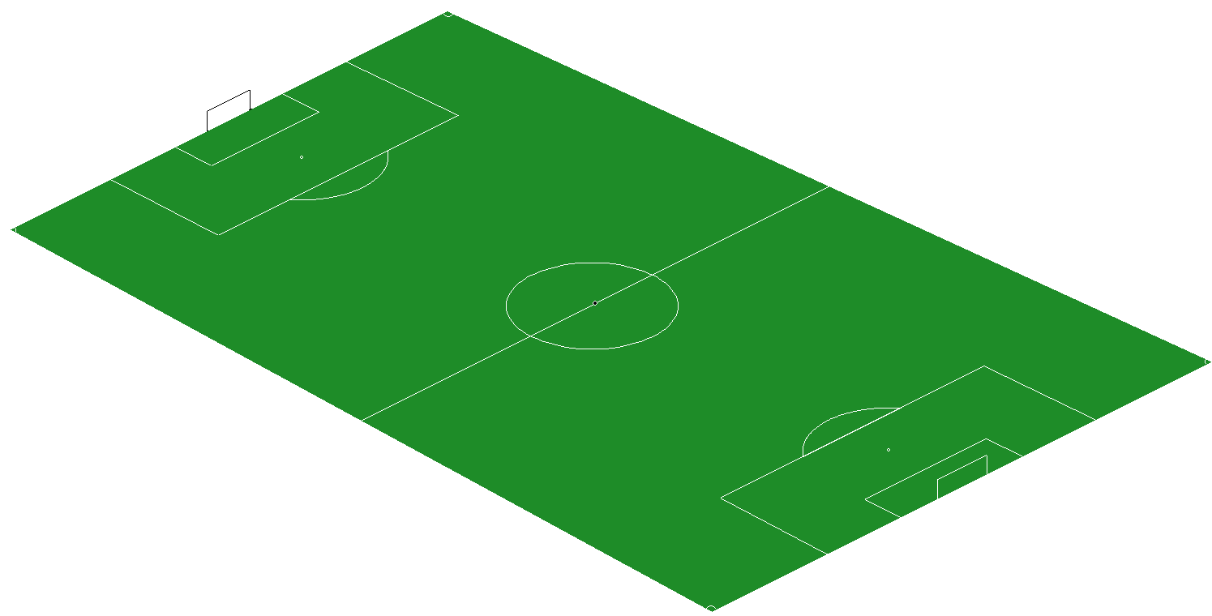
Dimensions – height
pz
:: Position3D = { pxy :: Position, pz :: Metre}
:: Football = { ballPos :: Position3D
, ballSpeed :: Speed3D
}

Slide 14
Dimensions – directions
(degree 90)
(rad (0.5*pi))
(degree 180)
(rad pi)
(degree 0)
(rad 0.0)
(degree 270)
(rad (1.5*pi))
:: Angle
degree :: Int -> Angle
rad :: Real -> Angle
pi :== 3.1415926535897932384

Slide 15
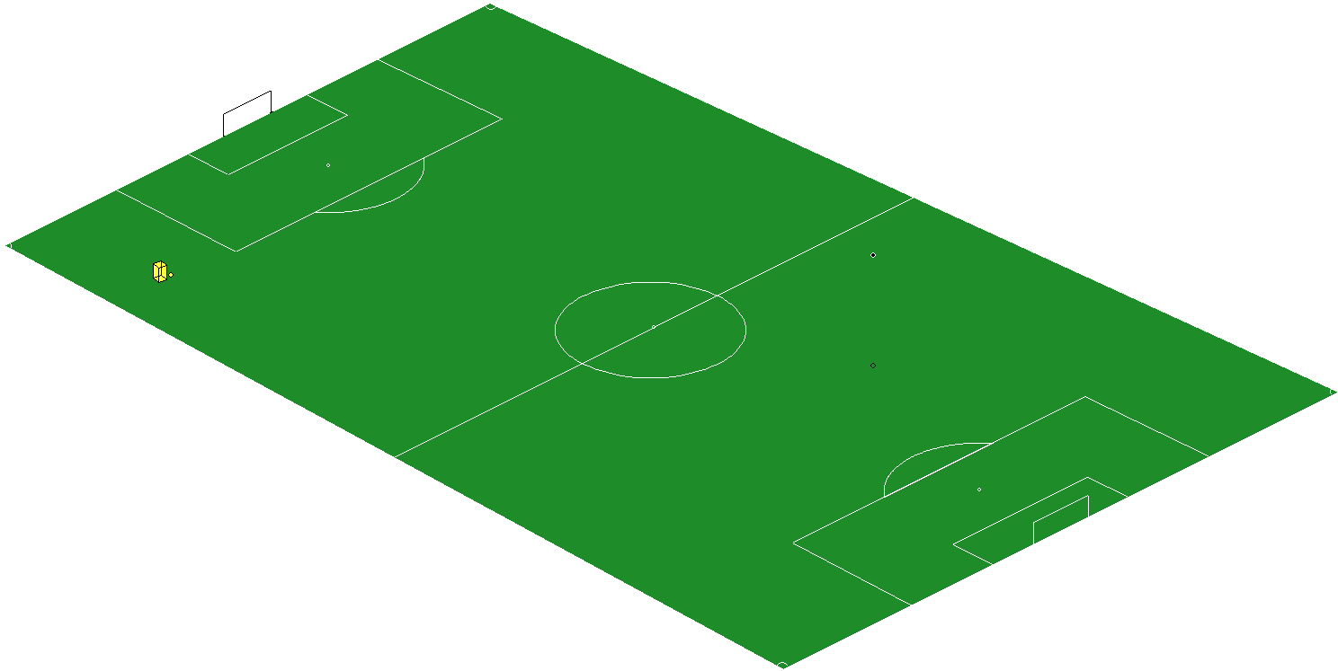
Dimensions – speed
… me.nose = ν …
{vxy={direction=β, velocity = ms 5.5}
, vz = ms 1.8 }
α
ν
β
{direction=α, velocity = ms 6.3}
:: Speed = {direction :: Angle, velocity :: Velocity }
:: Speed3D = {vxy :: Speed, vz :: Velocity }
:: Velocity
ms :: Real -> Velocity

Slide 16
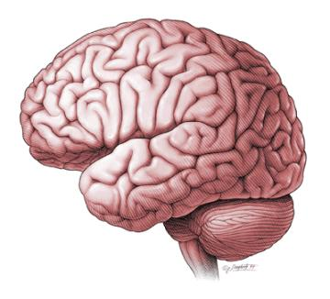
Program brains
+
=

Slide 17
“Our” brain is different
:: Footballer = E.m:
{ …
, brain :: Brain (FootballerAI m) m
}
:: Brain ai m = { memory :: m, ai :: ai }
:: FootballerAI m :== (BrainInput, m)
-> (BrainOutput, m)
myBrain :: (BrainInput, Memory)
-> (BrainOutput, Memory)

Slide 18
What does a football player know?
:: BrainInput
= { referee :: [RefereeAction]
, football :: FootballState
, others :: [Footballer]
, me :: Footballer
}
:: FootballState
= Free Football | GainedBy FootballerID

Slide 19
What can a football player do?
:: BrainOutput :== FootballerAction
:: FootballerAction
= Move Speed Angle | Feint FeintDirection
| GainBall | CatchBall
| KickBall Speed3D | HeadBall Speed3D
| Tackle FootballerID Velocity

Slide 20
Example 1: stand still
halt :: (BrainInput, m)
-> (BrainOutput, m)
halt (input, m)
= (Move zero zero, m)
module FootballerFunctions consists of a few miniscule brain functions

Slide 21
Example 2: run to a point
fix point diff (input=:{me}, m)
| d < diff = halt (input, m)
| otherwise = (move, m)
where
d = dist me point
a = bearing zero me point
r = bearing me.nose me point
move = Move {direction=a,velocity=ms (toReal d)} r

Slide 22
Example 2: run to a point
afterfix then_do point diff (input=:{me}, m)
| d < diff = then_do (input, m)
| otherwise = (move, m)
where
d = dist me point
a = bearing zero me point
r = bearing me.nose me point
move = Move {direction=a,velocity=ms (toReal d)} r
generalise fix with continuation action

Slide 23
Example 3: kick ball to point
kick point (input=:{me}, m)
| d <= maxKickReach me = (kick, m)
| otherwise = halt (input, m)
where
ball = getBall input
d = dist me ball
v = dist me point
a = bearing zero me point
kick = KickBall {vxy = {direction=a,velocity=ms (toReal v)}
,vz = ms 1.0 }

Slide 24
Example 4: track ball
track_ball diff (input,m)
= fix (getBall input).ballPos.pxy diff (input,m)
... what about the mini-effies?
miniFF diff (input,m)
= afterfix trap_bal_in_doel
(getBall input).ballPos.pxy diff (input,m)

Slide 25
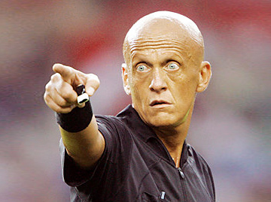
Referee
Referee observes game
Referee decisions must be obeyed
resuming game
playing half
Referee detect rule violations

Slide 26
Referee
:: BrainInput
= { referee :: [RefereeAction], … }
Violations:
hands, incorrect ball possession, dangerous play
Results in reprimand / game resumption:
warning, yellow card, red card
red card dismisses player from game

Slide 27
Referee
:: BrainInput
= { referee :: [RefereeAction], … }
Game resumption:
free kick, throw in, goal kick, center kick, corner
acting team: Home (West / East)
passive team: violation if it does not let the acting team perform resumption

Slide 28
Referee
:: BrainInput
= { referee :: [RefereeAction], … }
Signal scored goal:
:: RefereeAction = … | Goal Home | …
followed by center kick of other team (other)

Slide 29
Referee
:: BrainInput
= { referee :: [RefereeAction], … }
Signal half of game:
:: RefereeAction = … | EndHalf | …
players must keep track of this
brain (input=:{referee},m=:{half2})
= (…, {m & half2 = half2 || end1})
where end1 = any isEndHalf referee

Slide 30
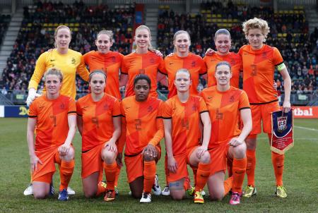
Team building

Slide 31
Team building
Team consists of 11 players:
:: Footballer = {playerID :: FootballerID, …}
:: FootballerID = { clubName :: ClubName
, playerNr :: PlayersNumber
}
Goal keeper has number 1
Fielders have numbers 2..
Players of team play for the same club

Slide 32
Team building
Module Team has all (training)teams
allAvailableTeams :: [Home FootballField -> Team]
Team is informed of:
where they are at the first half (Home)
the size of the football field (FootballField)
myteam :: Home FootballField -> Team
:: Team :== [Footballer]

Slide 33
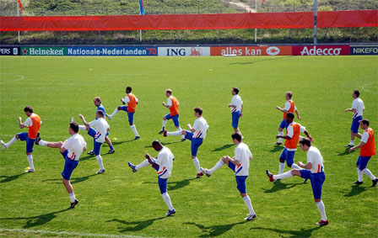
Brain training

Slide 34
Training 1: slalom
Referee: RefereeCoach_Slalom
Opponents: Opp_Slalom_W/E
You: Student Slalom_E/W
Module: Team_Student_Slalom_Assignment.icl
Use predictable mode for training

Slide 35
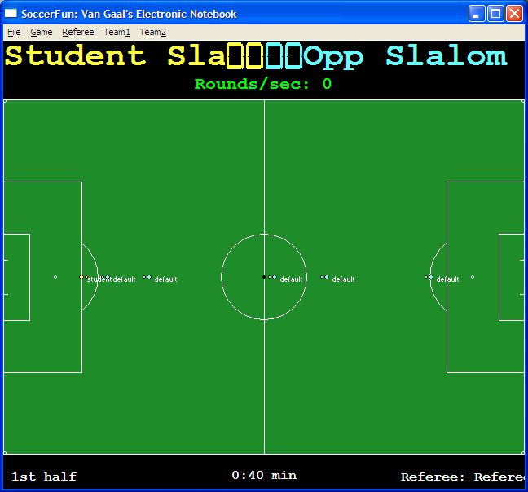
Training 1: slalom
slalom around your opponents
kick ball in goal opponent
Use predictable mode for training

Slide 36
Training 2: play ball
Referee: RefereeCoach Passing
Opponents: Opp_Passing_W/E
You: Student Passing_E/W
Module: Team_Student_Passing_Assignment.icl
Use predictable mode for training

Slide 37
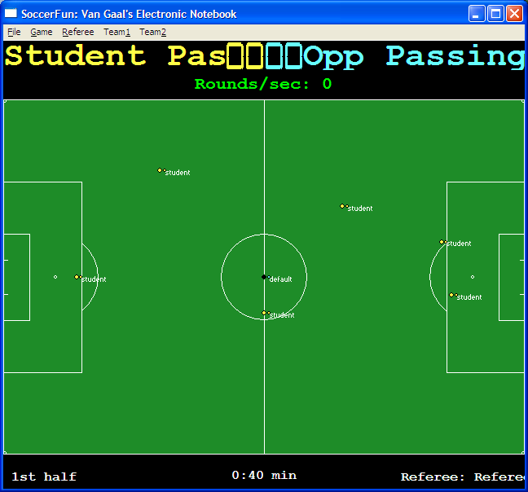
Training 2: play ball
Use predictable mode for training

Slide 38
Training 3: timing of play ball
Referee: RefereeCoach DeepPass
Opponents: Opp_Deep_Pass_W/E
You: Student Deep Pass_E/W
Module: Team_Student_DeepPass_Assignment.icl
Use predictable mode for training

Slide 39
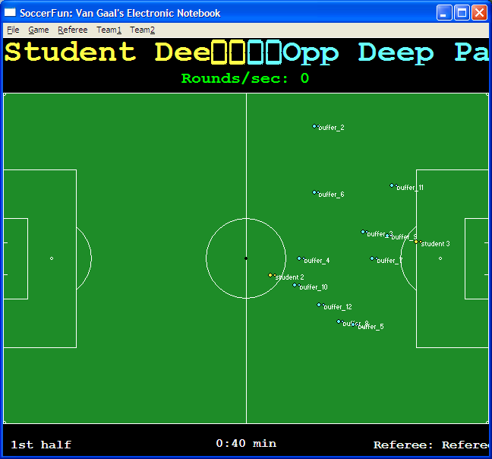
Training 3: timing of play ball
Gain ball
Play ball to player 3 such that no opponent can gain the ball.
Use predictable mode for training

Slide 40
Training 4: protect goal
Referee: RefereeCoach Keeper
Opponents: Opp_Keeper_W/E
You: Student Keeper_E/W
Module: Team_Student_Keeper_Assignment.icl
Use predictable mode for training

Slide 41
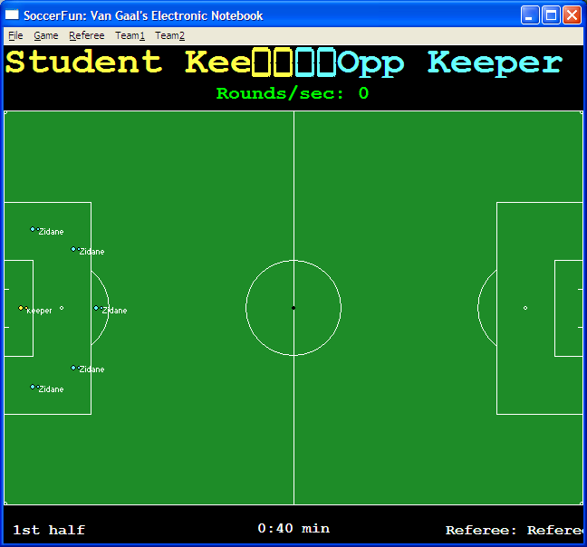
Training 4: protect goal
Goal keeper protects goal.
Opponents play ball to each other and attempt to score a goal.
Use predictable mode for training

Slide 42
Read more:
Overview Soccer-Fun: see SoccerFun\doc\quickstart_SoccerFun.pdf
Soccer-Fun home site: http://www.cs.ru.nl/P.Achten/SoccerFun/SoccerFun.html

